Slide 1
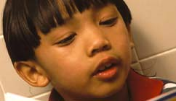
The flagship public television and radio station in the nation's capital
WETA Learning Media

Slide 2
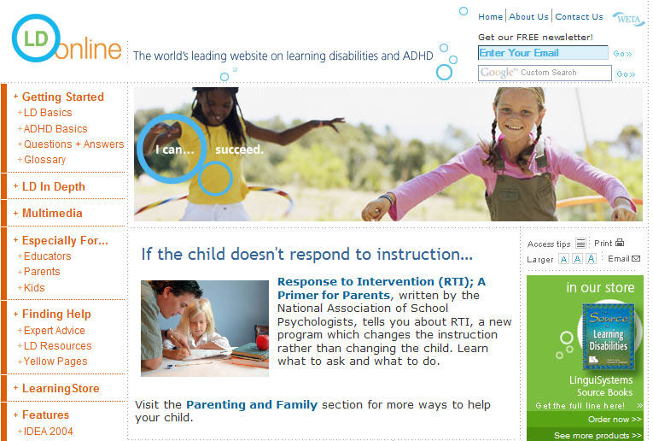
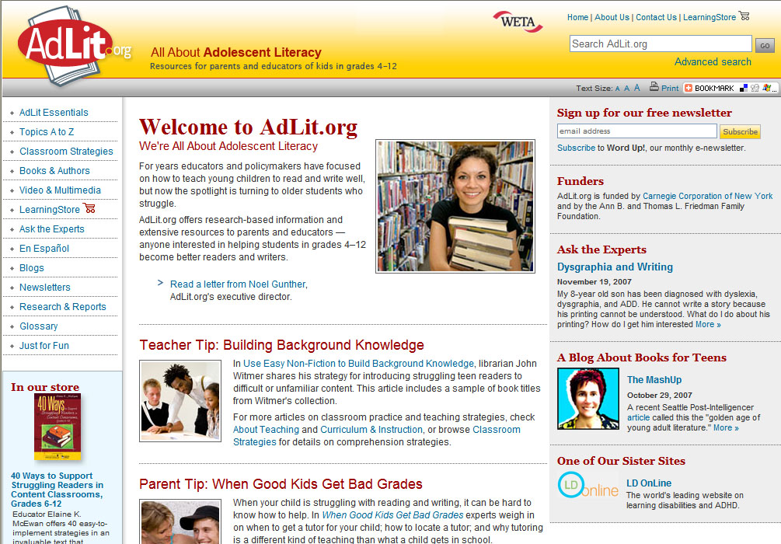
WETA Learning Media
Our Education Projects

Slide 3
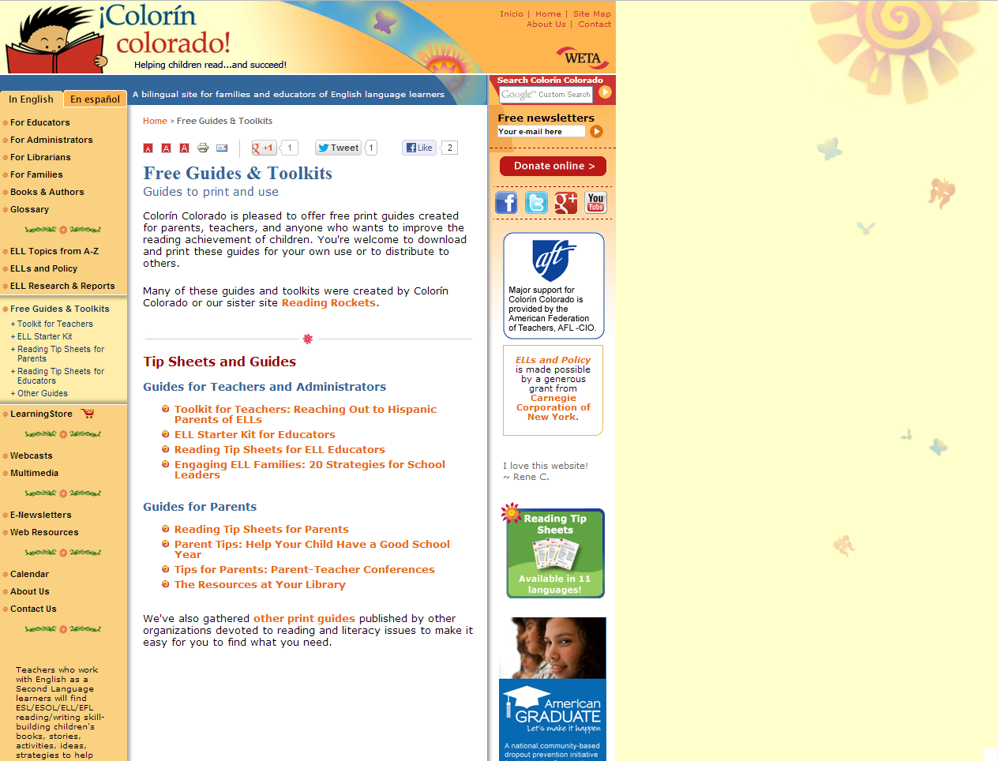

Slide 4
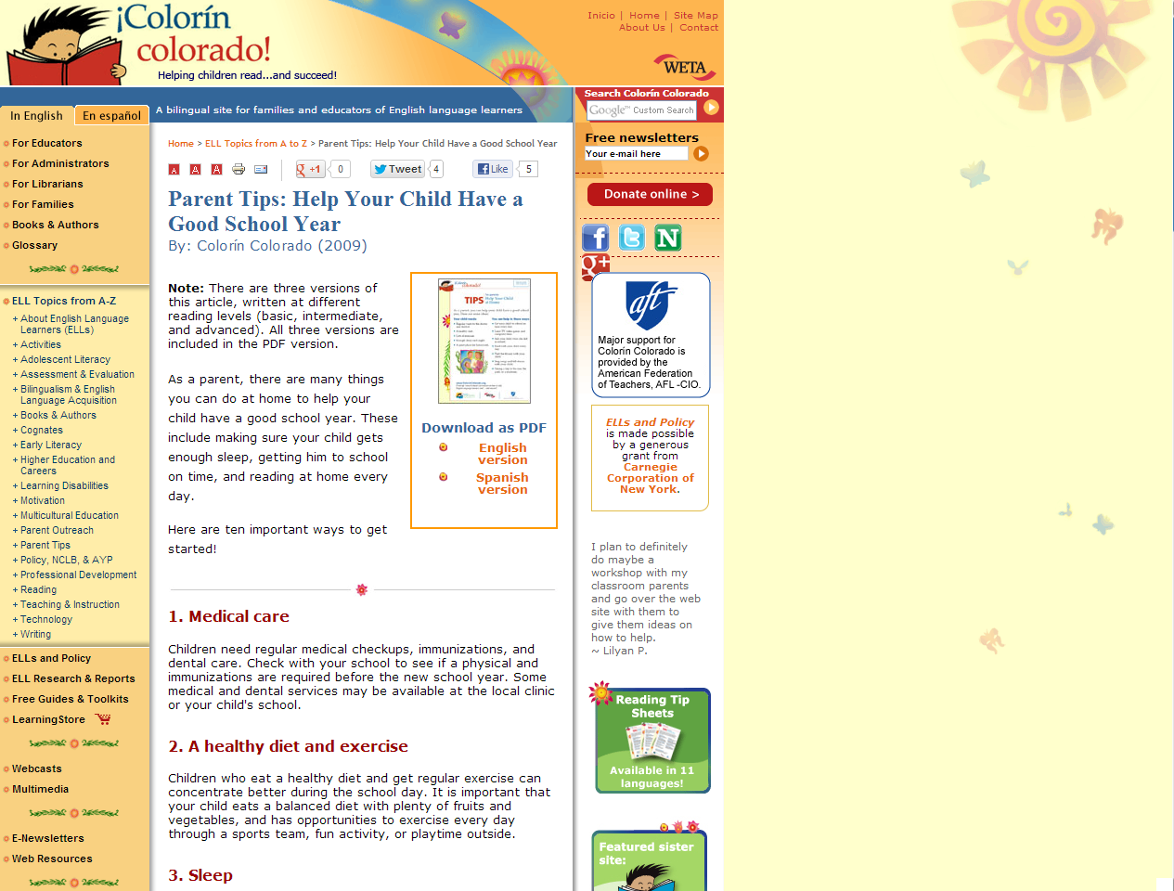

Slide 5
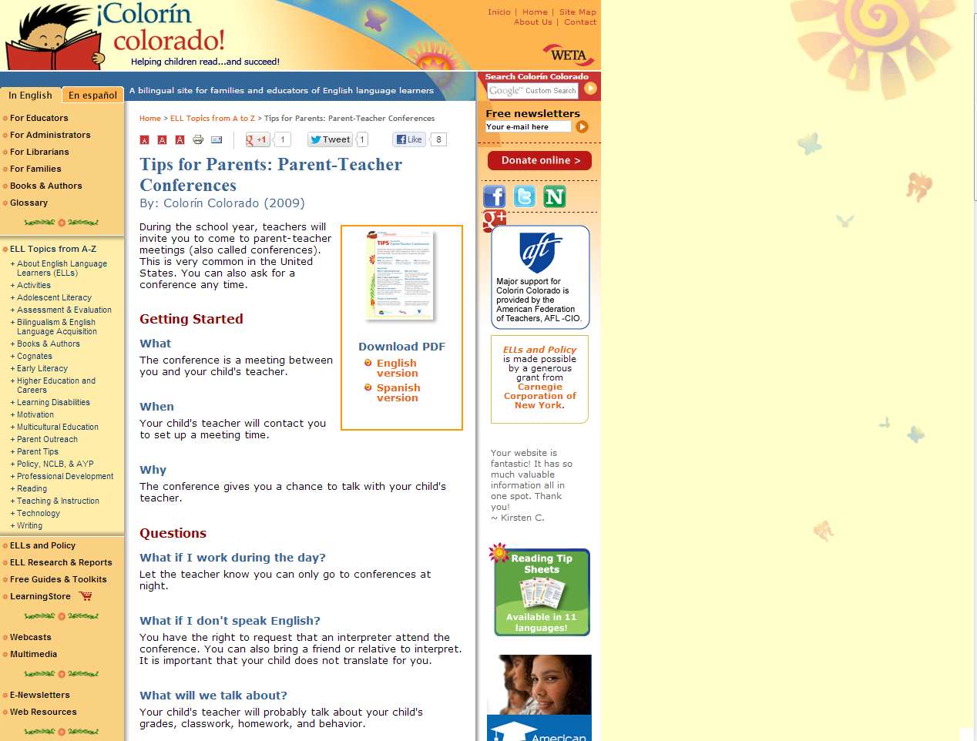
Parent Tips: Parent-Teacher Conferences
http://www.colorincolorado.org/article/33953

Slide 6
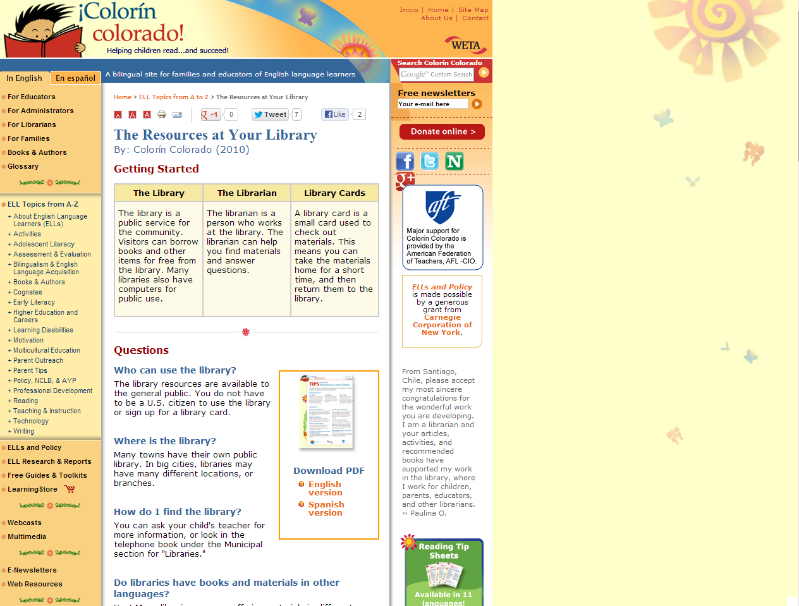
Parent Tips: The Resources at Your Library
http://www.colorincolorado.org/article/37044

Slide 7
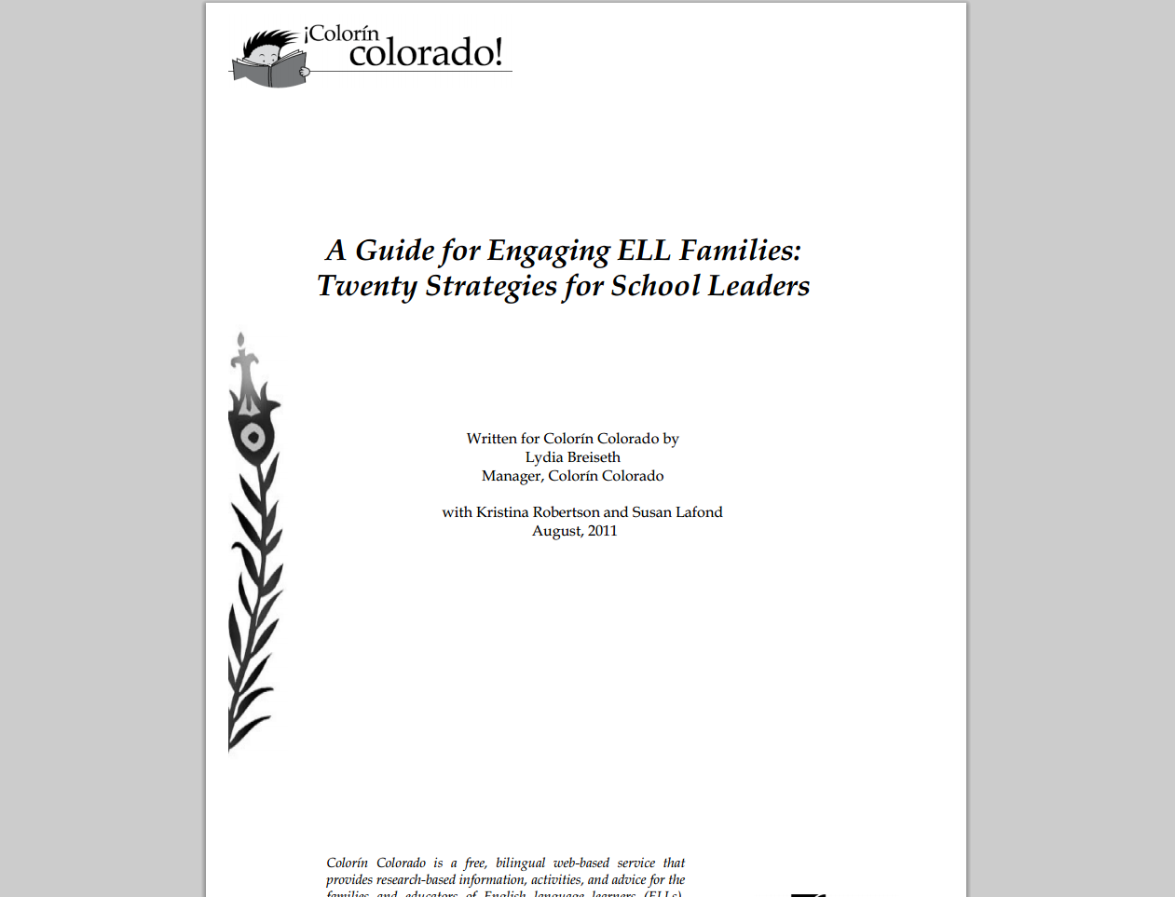
Engaging ELL Families: 20 Strategies for School Leaders & Administrators
http://www.colorincolorado.org/pdfs/guides/Engaging-ELL-Families.pdf

Slide 8
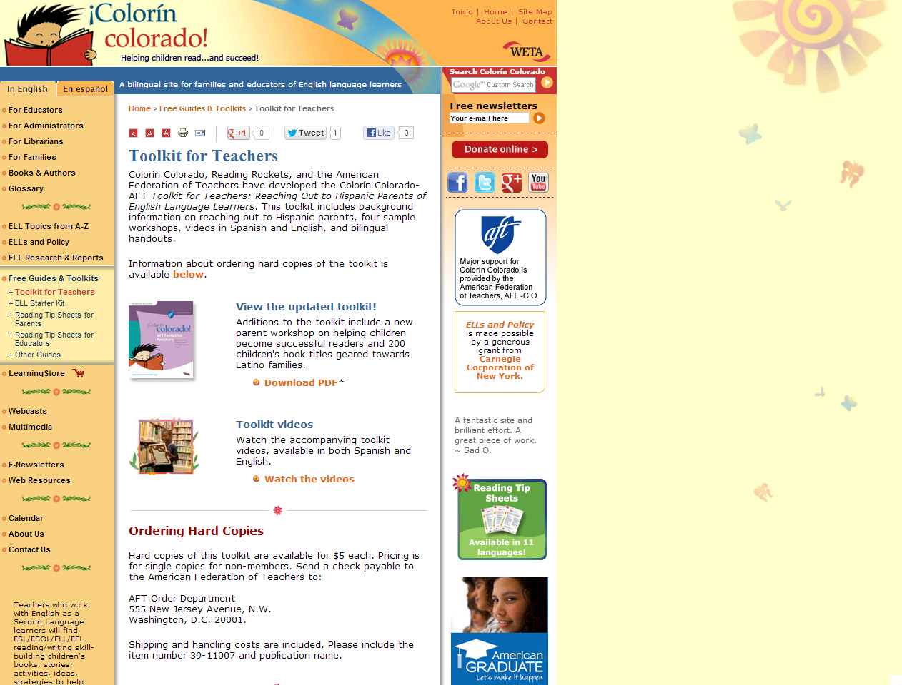
Toolkit for Teachers: Reaching Out to Hispanic Parents of ELLs
http://www.colorincolorado.org/guides/toolkit

Slide 9
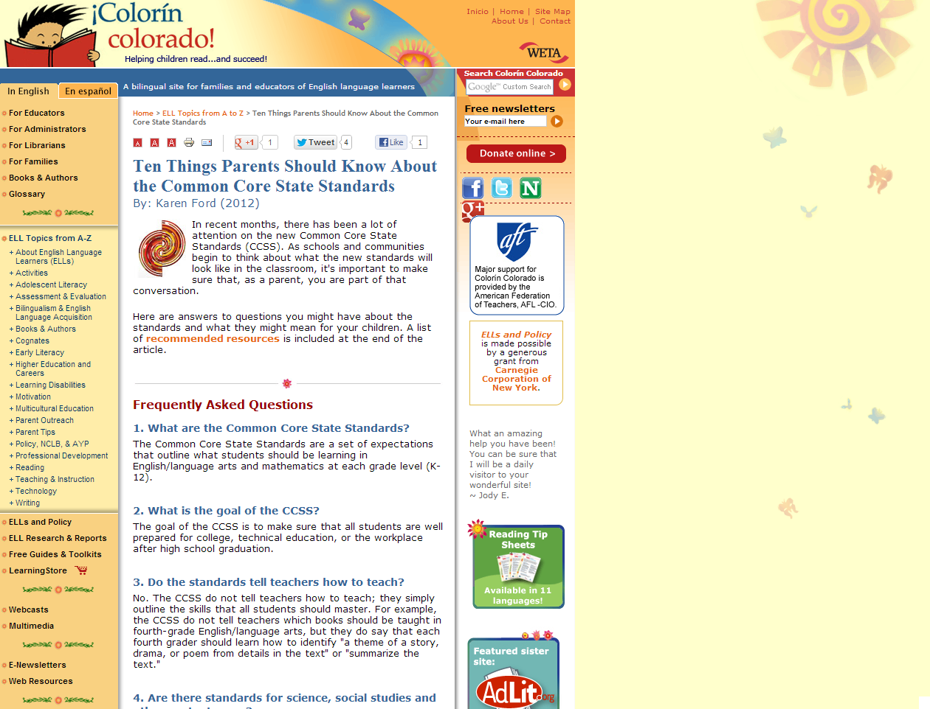
Ten Things Parents Should Know About the Common Core State Standards
http://www.colorincolorado.org/article/53565/

Slide 10
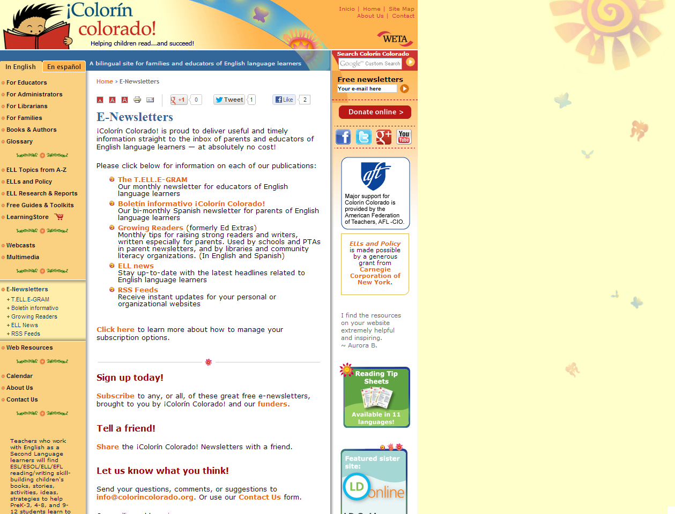
E-Newsletters, ELL news, RSS Feeds
http://www.colorincolorado.org/newsletters/

Slide 11
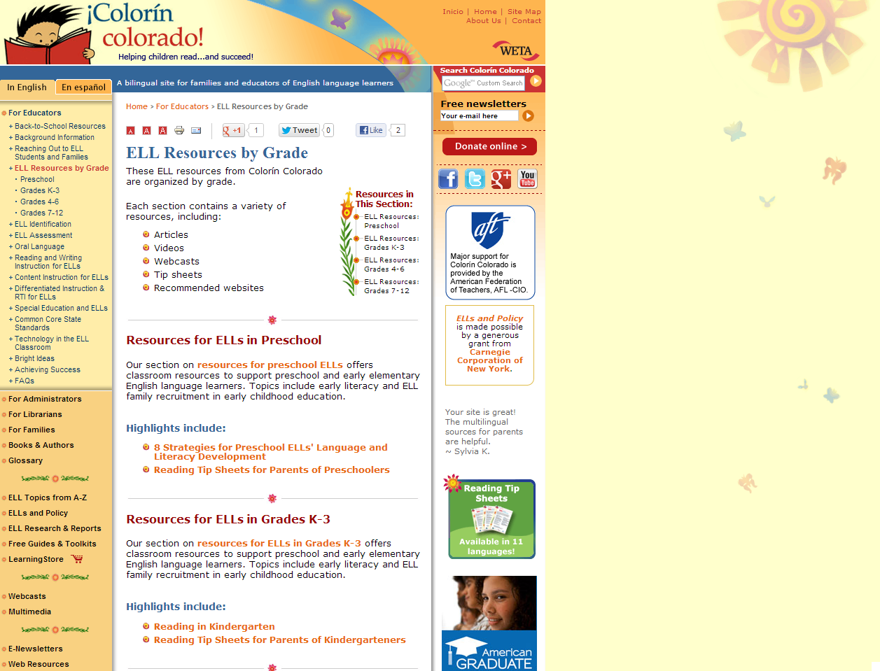
ELL Educator Resources by Grade
http://www.colorincolorado.org/educators/ell_resources/

